Slide 1
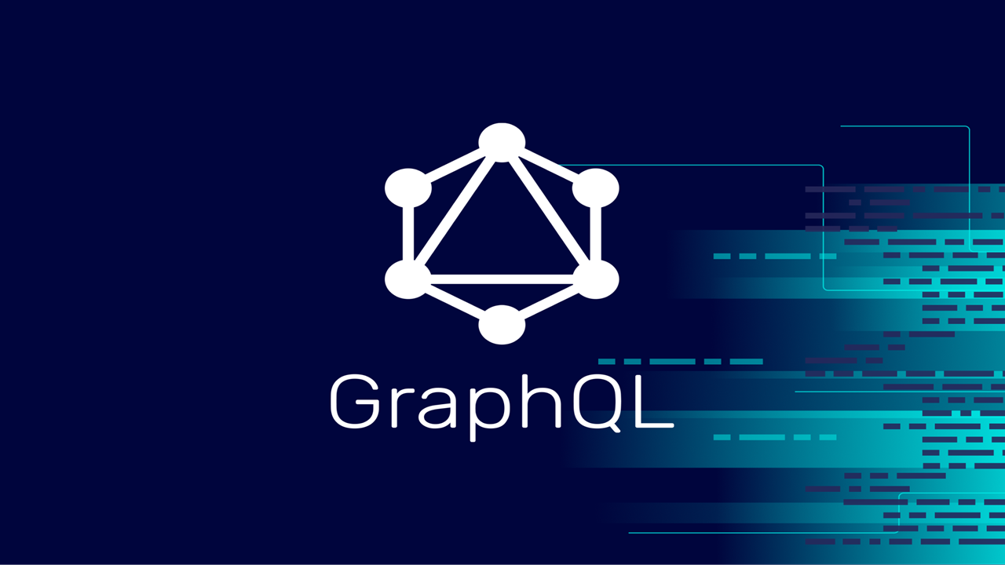
Graph Query Language

Slide 2
Introduction to GraphQL
Definition: GraphQL is a query language for APIs that allows clients to request specific data and shape the response based on their needs.
Schema: GraphQL APIs are schema-driven, with a defined schema that describes the available types, fields, queries, and mutations.
Advantages: Provides a flexible and efficient way to fetch and manipulate data, reducing over-fetching and under-fetching of data.

Slide 3
GraphQL Schema
Types: Define GraphQL types (e.g., Object types, Scalar types, Enum types, Interface types, Union types) to represent data structures
Fields: Specify fields within types, including scalar fields, object fields, and nested fields for complex data structures
Queries: Define query types for fetching data from the GraphQL API, with customizable fields and parameters
Mutations: Define mutation types for performing write operations (create, update, delete) on data, with input parameters and return values

Slide 4
Querying Data with GraphQL
Query Syntax: Use GraphQL query syntax to specify the data requirements, including fields, nested fields, aliases, arguments, and fragments
Execution: Execute GraphQL queries against the API endpoint to retrieve precisely the requested data structure
GraphiQL: Explore and test GraphQL queries interactively using tools like GraphiQL or GraphQL Playground

Slide 5
Mutating Data with GraphQL
Mutation Syntax: Use GraphQL mutation syntax to perform write operations (create, update, delete) on data
Input Types: Define input types for mutation operations, specifying input fields and validation rules
Error Handling: Handle errors and validation failures in GraphQL mutations, returning meaningful error messages and status codes

Slide 6
GraphQL Resolvers
Resolver Functions: Implement resolver functions for each field in the GraphQL schema, fetching data from backend services or databases
Data Fetching: Use resolver functions to fetch data for queries and mutations, resolving nested fields and relationships
Optimization: Optimize resolver functions for performance, batching data fetching operations, and handling caching strategies

Slide 7
Advantages of GraphQL APIs
Flexible Queries: Clients can request precisely the data they need, reducing over-fetching and under-fetching of data
Single Endpoint: GraphQL APIs have a single endpoint for all data operations (queries, mutations), simplifying API interactions
Type System: Strongly typed schema ensures data consistency, validation, and documentation within the API
Real-time Updates: Support for real-time subscriptions to receive live updates from the API based on specified criteria

Slide 8
GraphQL vs. RESTful APIs
Data Fetching: GraphQL allows precise data fetching with a single request, while RESTful APIs may require multiple requests for related data
Response Structure: GraphQL responses are structured based on the query, providing only the requested fields, while RESTful APIs return fixed data structures
Versioning: GraphQL APIs do not require versioning due to schema evolution, whereas RESTful APIs may need versioning for backward compatibility
Complexity: GraphQL APIs can be more complex to implement and maintain due to the schema definition and resolver functions

Slide 9
Best Practices for GraphQL APIs
Schema Design: Design a clear and consistent GraphQL schema with well-defined types, fields, queries, and mutations
Pagination: Implement pagination strategies (cursor-based, offset-based) for large datasets in GraphQL queries
Security: Secure GraphQL APIs with authentication, authorization, and input validation to prevent malicious queries and mutations
Performance Optimization: Optimize resolver functions, implement caching strategies, and monitor API performance for scalability

Slide 10
Testing and Debugging GraphQL APIs
Unit Testing: Test GraphQL resolvers and schema with unit tests to ensure functionality and data consistency
Integration Testing: Test end-to-end GraphQL interactions, including query validation, error handling, and data mutations
Tool Support: Use tools like Apollo Client, GraphQL Inspector, and GraphQL Playground for testing, debugging, and monitoring GraphQL APIs
Error Handling: Handle errors gracefully in GraphQL responses, providing meaningful error messages and status codes

Slide 11
Real-world Examples of GraphQL APIs
Popular APIs: Showcase examples of popular GraphQL APIs (e.g., GitHub GraphQL API, Shopify GraphQL API, SpaceX GraphQL API)
Use Cases: Explore real-world use cases of GraphQL APIs in various domains (e-commerce, social media, IoT, etc.), highlighting the benefits and challenges
Benefits: Discuss the benefits of GraphQL APIs in terms of data flexibility, developer productivity, and client-server interactions

Slide 12
Future Trends in GraphQL APIs
Adoption: Continued adoption of GraphQL in various industries for flexible and efficient data fetching
Tooling: Advancements in GraphQL tooling, frameworks, and libraries for better developer experience and performance
Standardization: Efforts towards standardizing GraphQL specifications, best practices, and governance for broader adoption
Integration with Microservices: Integration of GraphQL APIs with microservices architectures for data aggregation and composition

